Slide 1

Finding & Evaluating Research
Please open a web browser and pull up these websites:
Tab 1 – http://library.marist.edu/
Tab 2 – https://www.google.com/

Slide 2
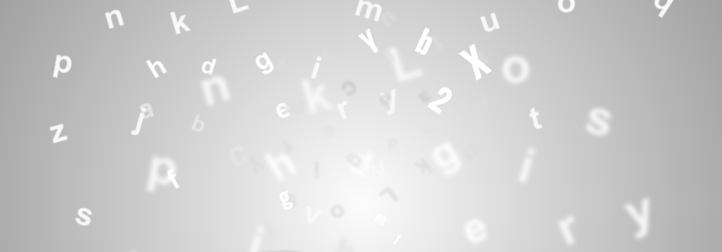
Google Search
Searching the entire internet
Basic information
Strengths: Popular culture and locating people and places
Search results not ranked strictly by relevance
Shows part of the conversation about a topic
Notes:
Google—no demonstration
General internet search -The good, the bad, and the ugly
-Emphasize that there are varying levels of quality out there
.com vs. .org vs. .edu vs. .gov
-Don’t rely on this domain designation as a measure of quality
Evaluate them all
-Examples (don’t pull up, just mention):
-Martinlutherking.org—white supremacist website
-Examine.com—source for dietary supplement information, advisory board members have stake in nutrition and supplement industry
Basic information
-Summarizes information, no original research
-Good starting point if you do not know much about a topic
Strengths
-Popular culture, great for finding information about people, businesses, and locations
Search Results Ranking
-Sources ranked often not by relevance or value, but by number of visits or paying to climb up the results list
-Source for evaluation activity from several years ago climbed up the list, because we had all First Year Seminar students clicking on it to see how it was a bad source
Shows part of the conversation about a topic
-i.e. blogs, magazines, newspapers, websites, social media, etc,
-rare exposure to scholarly sources, often asked to pay for them if you find them

Slide 3
Your Library’s Catalogue
General search of library materials, both print and online
Presents more of the conversation about a topic with general audience sources and scholarly ones
Can be overwhelming, but specialized limits to sculpt and shape your results
Good starting point for your research
Notes:
-General library search, searches all library collections, print and online, similar to Google with one search and you get access to a lot of sources.
-Get more of the research conversation about a topic, as it has general and specialized sources
-Can be overwhelming, but a good starting point
-Only provides full text items
Take students to course pathfinder to use Fox Hunt there, if they have one, otherwise use library homepage.
Searching Activity
Introduce Activity—explaining that students will be searching quickly for assigned topics in Fox Hunt and Google
-Students will search in Fox Hunt and Google for assigned topics provided on slides, in between each search, librarians will discuss important points about each search engine.
-Search in both Google and Fox Hunt

Slide 4
Research Task 1
Search for pictures of mammoths
Notes:
1-Find a picture of a mammoth
Point out ease of use with Google, several steps for Fox Hunt potentially
Fox Hunt thinks differently, looks for what college community would need for research. Google is more general audience, what do we look for most often, basic information and pictures.
Can find images in Fox Hunt, need to use limits to do so.

Slide 5
Research Task 2
Search for scholarly articles about mammoths
Notes:
2-Find a scholarly article about mammoths
-Limit for this type of source
-Asked to pay on Google, potentially, may only show Open access articles

Slide 6
Research Task 3
Search for John Legend
What types of sources do you find in the top ten results?
Notes:
3-Search for John Legend
-What types of sources do you find in Google in top ten?
Social media, wikipedia
-What types of sources do you find in Fox Hunt in top ten?
Books, articles
Don’t find much on John Legend, initially, Fox Hunt searches for words, doesn’t go to most popular searches with those terms as Google does. Fox Hunt also searches historically

Slide 7
Research Task 4
Search for reviews of the movie,
Avengers: Infinity War
Notes:
4-Find reviews of the movie, Avengers: Infinity War
-Both sources have reviews from same place, but from different places too, some more reputable than others

Slide 8
Select the Best Places to Search
Google Search is not designed for college level research.
The college library has higher level sources and tools for college level research.
But library search engines are not always as easy to use as Google.
Notes:
Select the Best Places to Search
-Many ways to search for information, one is not necessarily better than the other, but will bring you different types of information.
-For college research there is the expectation that you will move beyond basic search engines with basic types of sources to more advanced searching and sources.

Slide 9
Search Techniques
Don't search in full sentences, select the key concepts from your research question to use as keywords
Combine keywords with "and" "or" and "not“
education AND poverty
capital punishment OR death penalty
Use quotation marks to do a more targeted search AKA phrased searching
"evolutionary theory“
"college education" AND immigration
Notes:
Search Techniques
1- Don’t search in full sentences, select key concepts from your research question to use as keywords
2- Keyword searching and connectors/Boolean
review examples and discuss how to connect with Boolean operators
3- Phrased searching (targeted searching using quotation marks)
review examples and discuss impact of phrased searching on search results
4- Use post search limiters to refine search
5- Search with synonyms and related terms, try alternatives

Slide 10
This Can be Challenging!
Don't give up or change topics!
Search with synonyms and try different combinations of keywords to find better search results
university=college
poor=poverty
politics=government
success=achievement
Ask for help in the library

Slide 11
Well What about Google Scholar?
scholar.google.com = searches the “scholarly” part of the internet
Strength is in articles
Connects you to sources that are available online
Wider exposure to the conversation about a topic
Notes:
Demonstrate, using keywords based upon class topic
Searches the “scholarly” part of the internet
-Google sets the parameters for what is considered scholarly so questionable sources do get in there
-Focuses on what their webcrawlers can easily locate and index, so sources that have no online presence will most likely not appear
Strength is in articles
Connects you to Marist sources that are available online
Wider exposure to the conversation about a topic
-Sources the Marist library does not have
Demonstrate Linking abilities of Google Scholar—Students do not follow along

Slide 12
Subject Databases in Your Library
Subject specific universes of information
Specialized limits and account services
Strength is usually in articles
Connects you to sources that are available online and in the library
Wider exposure to the conversation about a topic
Notes:
Subject Databases
Demonstrate database, selected based upon class topic, students follow along
- Subject specific universes of information
-Not as overwhelming as they are much smaller than tools like Fox Hunt and Google Scholar
Specialized limits and account services
Strength is usually in articles
Connects you to Marist sources that are available online and in the library
- Wider exposure to the conversation about a topic
-Sources the Marist library does not have
Point out subject databases on course pathfinder/subject guide.

Slide 13

Evaluating
Why Evaluate a Source??
To determine if the source:
-- is valid and trustworthy
-- provides the information needed to answer your research question
Notes:
Why evaluate? Filter and assess information to find information that fits your information needs and is valid, reliable and trustworthy.

Slide 14
Image Evaluation
Imagine you are in a class on slavery in America and must do a presentation on Nat Turner's Slave Rebellion
Now find a portrait of Nat Turner for this presentation using a Google image search
How do you know that this is Nat Turner?
Library resources such as encyclopedias can be used to verify this
Notes:
Break students into groups of 3-4, ask groups to find a portrait of Nat Turner using a Google image search.
Once they have selected a portrait, they must verify that this is Nat Turner using Wikipedia or library encyclopedias.
Librarians should show students how to locate encyclopedias on the course pathfinder or the Reference Shelf
Librarians perform the same image search and ask groups which image they picked and solicit how they verified that it was indeed Nat Turner.
Even if no one picks a Frederick Douglass image, discuss with them why you had them do this, explaining that this was an actual assignment and the students selected the image of Frederick Douglass, show them websites that pair Frederick Douglass with story of Nat Turner.
- Emphasize that this critical/skeptical eye is essential in all types of information even the small things. This is a life skill

Slide 15
Evaluation Method--CRAAP
Currency
When was it published? Does this matter for your research? How old are the data and facts?
Relevance
Is it related to your research question? Does it fulfill your research needs?
Authority
Who wrote or published the work? What are their credentials? What sources do they use?
Are the sources listed? What type of source is it?
Accuracy
Is this information true and reliable? Is the author being objective?
Purpose
Why was this source created? Does it have a purpose other than sharing information?
Notes:
Evaluation Activity: Evaluation activity in groups/ individually on handout w/ slip of paper indicating Library source to search in Fox Hunt and evaluate. These sources are selected based upon the class topic by the librarians responsible for this workshop. Students must fill in CRAAP criteria.
1- Directions: Search for Library source in Fox Hunt. Evaluate the source based on CRAAP criteria.
2- Review exercise when completed. What were the students’ findings? Would they use the sources in a research paper? In personal life?

